Slide 1
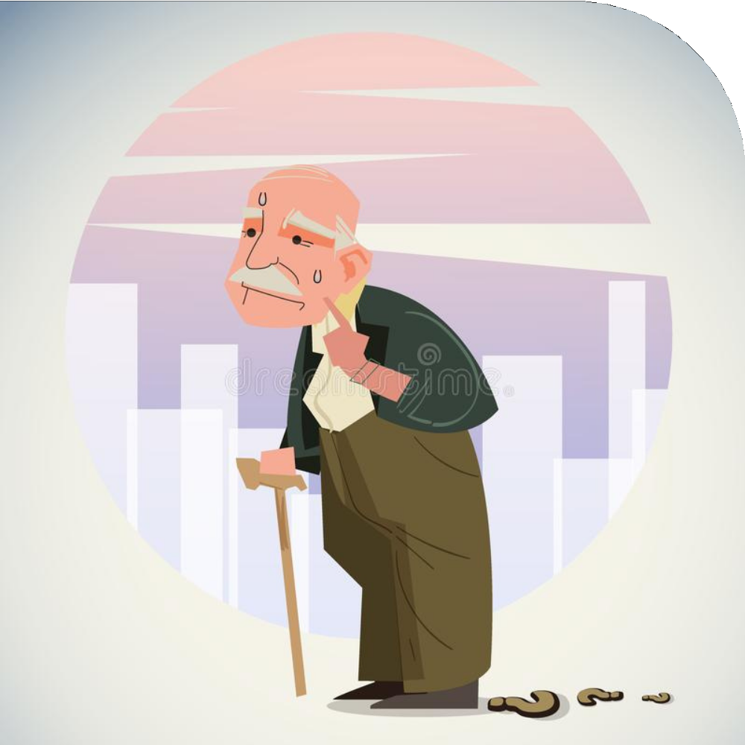
Ever seen
an old person lost his way because they can't
recall
their contact details or address or their way
to home ?

Slide 2
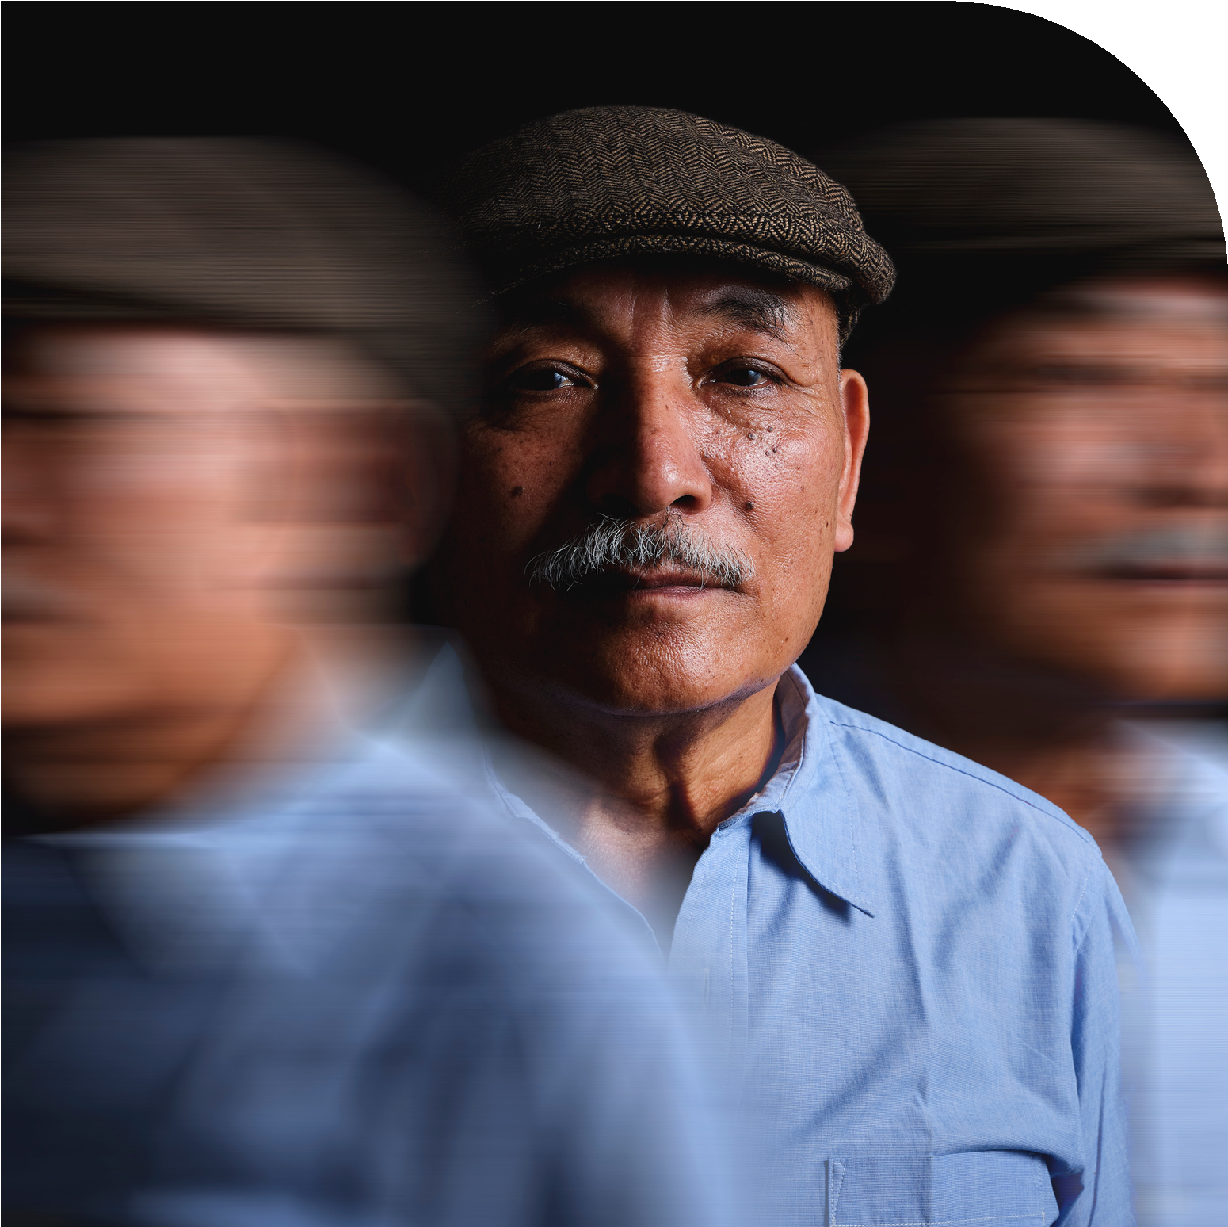
Or a person with Dementia or Alzheimer finding their
way to home or their loved ones?

Slide 3
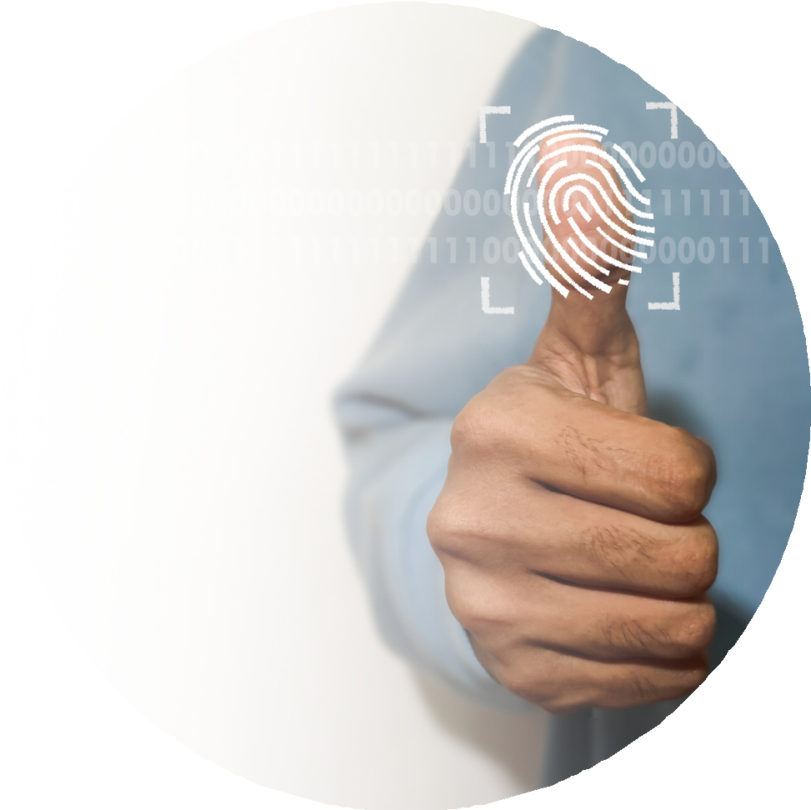

TALAASH
-Find your loved ones.........

Slide 4
Problem Statement-
Portal for tracking/finding of missing person by use of Adhaar enabled Biometric details

Slide 5
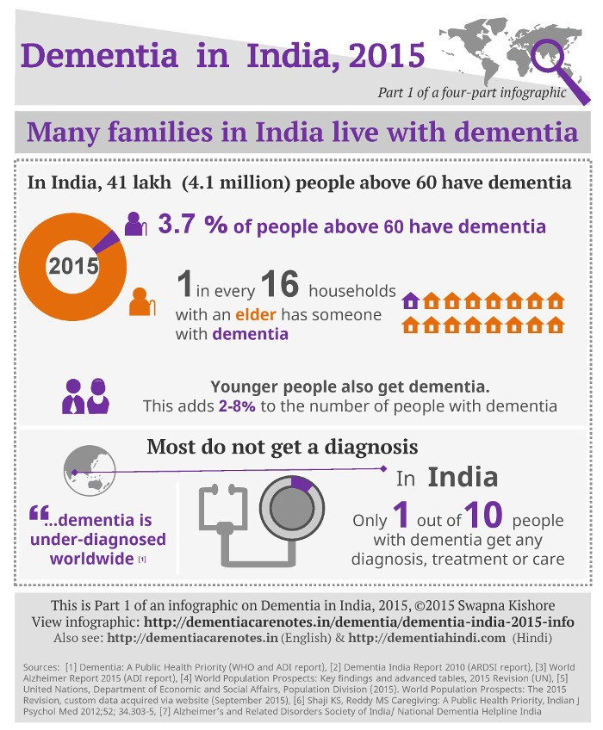
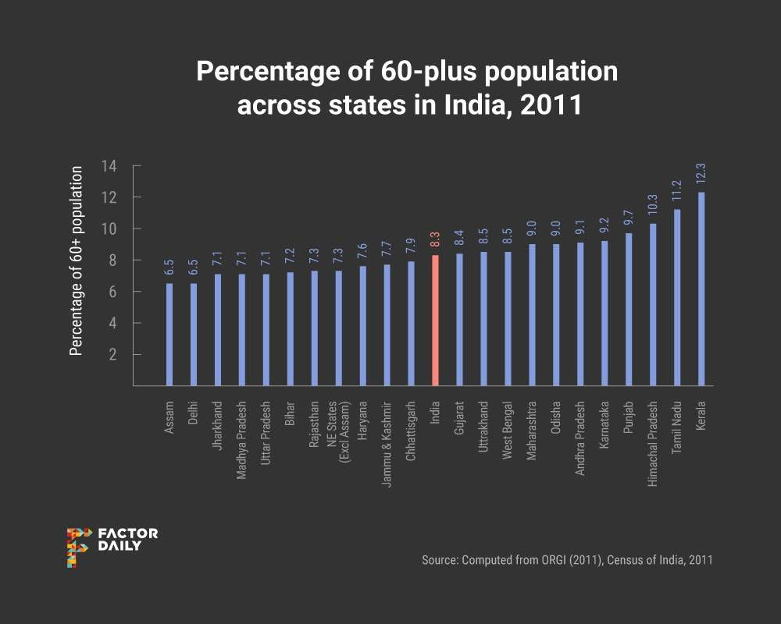
Based on the data given

Slide 6
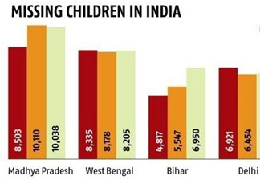

Problems to Solve -
To track a missing family member
To identify and gather some information about suspicious missing
person
To track missing people by involving general public

Slide 7
Our portal will do face recognition or will give the person's detail by matching the fingerprint
If you find someone , report to police station
Police will collect information like fingerprint or image
Help people meet their loved ones
Key Points -
Only Government agencies can use the portal
Two options are available - Use Fingerprint of the victim Take a picture of the victim
Unsupervised Machine Learning algorithm for facial recognition
Open CV for fingerprint detection

Slide 8
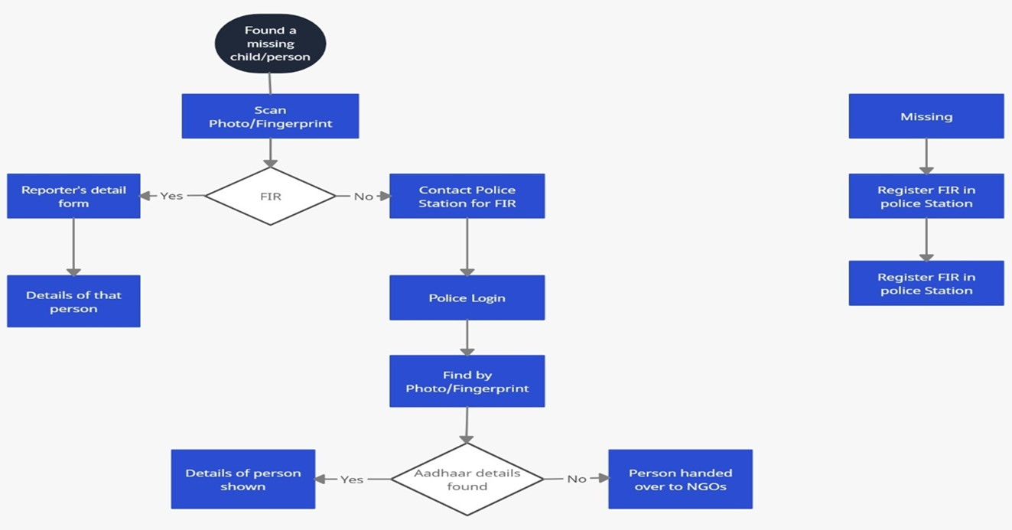
Flow Of Software

Slide 9
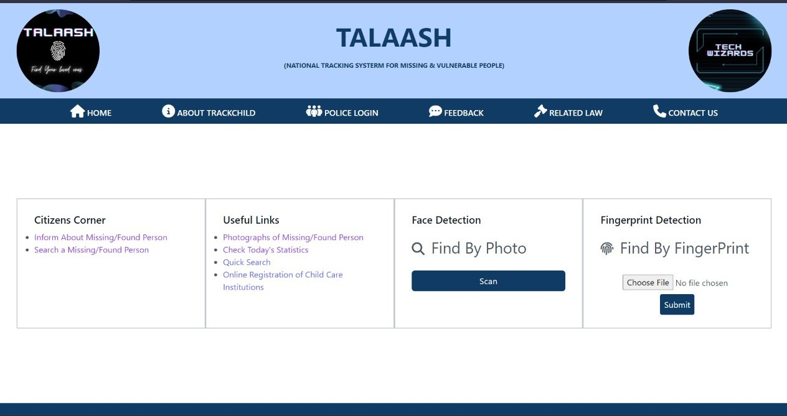
Images / Architecture of Working Project -

Slide 10
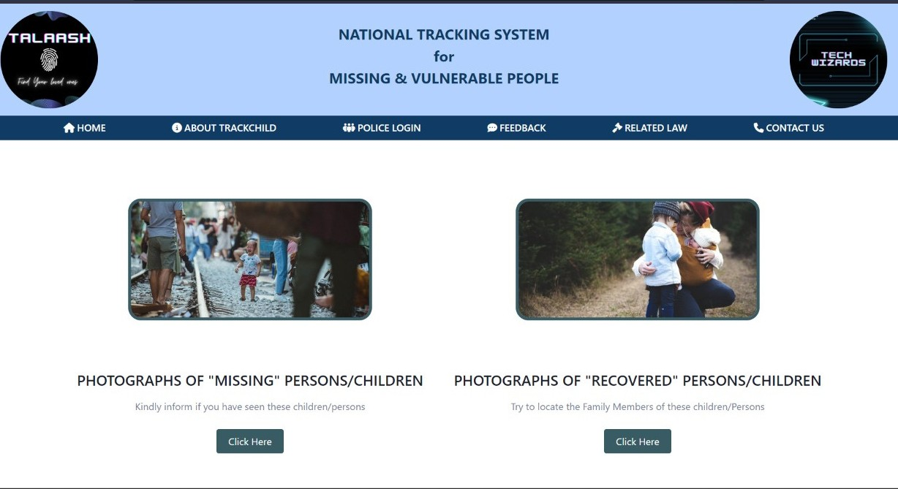
Photograph / Gallery Page of Missing and Recovered People

Slide 11
Dependencies
Show Stopper
The process of tracking a missing person will be far more digitalized and smooth helping the Police and officials to track down people faster than the conventional process.
The Image Matching and the Fingerprint Scanning Methods makes the process more accurate and reliable.
Massive data storage burden. The ML technology used in face detection requires powerful data storage.
False positives, where the algorithm matches a query image with a face from the known-faces database erroneously.
Time Latency.

Slide 12

Future Scope and Application
Integration of our system with Government Adhaar Database to widen the reach and use of our website
For better reach and usability, An Android Application will also be build which will facilitate all the features of our website
Our website can be further extended in future to take help for tracking criminals by face recognition.

Slide 13
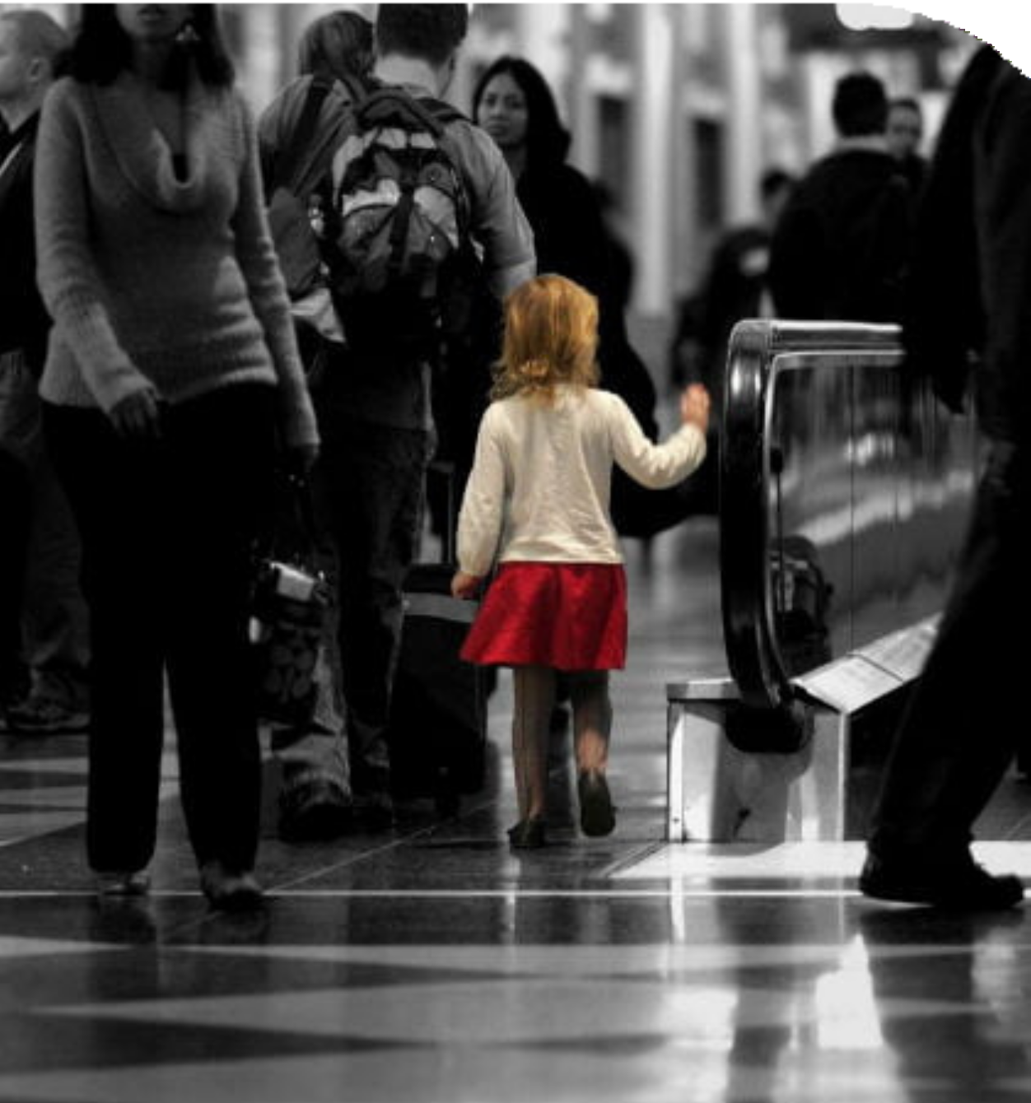
Ever Seen a
Lost Child?

Slide 14
Future Scope and Application
Help missing/vulnerable children using previous missing reports and current biometric details with the help of AI
Collab with NGOs for better reach and use of our portal
Digitalize the FIR registers of Police Station

Slide 15




Our Tech Stack-
Machine Learning Model :
Face Recognition & Fingerprint
Image Processing :
Face Recognition
Python :
Machine Learning & Deep Learning
HTML/CSS/TAILWINDCSS :
Frontend
MongoDB :
Database
Flask :
Backend
5. SQLite 3 :
Hashing and Authentication

Slide 16
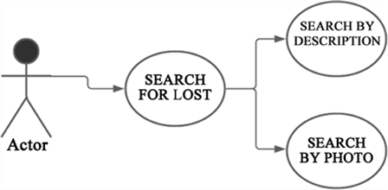
Missing Cases ( Use Case Diagram)
Use Case Diagram for Missing person

Slide 17


